Slide 1
Linked List
Single Linked List & Doubly Linked List
Muhammad Haffad Addakhil (18650105)

Slide 2
Linked List: Intro
Merupakan koleksi linear dari data, yang disebut sebagai nodes, dimana setiap node akan menunjuk pada node lain melalui sebuah pointer.
Didalam suatu node memiliki dua bagian yaitu data dan pointer.
Pointer digunakan untuk menunjuk data selanjutnya.
Head
Node
1
2
3
Null
data
pointer

Slide 3
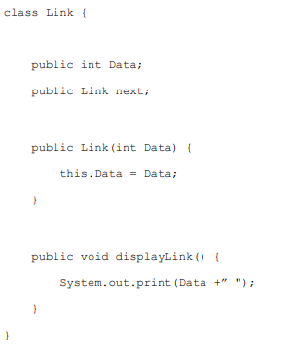
Linked List : Single Linked List
Pada source code disamping, kita akan membuat class Node (pada modul namanya ‘Link’)
Data
next

Slide 4
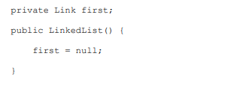
Linked List : Single Linked List
.
LinkedList theList = new LinkedList();
theList.insertFirst(22);
theList.insertFirst(44);
LinkedList theList = new LinkedList();
Head / First
Null
/ head

Slide 5
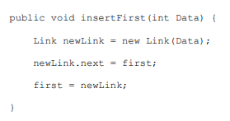
Linked List : Single Linked List
theList.insertFirst(22);
Head / First
22
LinkedList theList = new LinkedList();
theList.insertFirst(22);
theList.insertFirst(44);
Null
Head / First
22
Null
Head / First
22
Null

Slide 6
Linked List : Single Linked List
theList.insertFirst(44);
LinkedList theList = new LinkedList();
theList.insertFirst(22);
theList.insertFirst(44);
Head / First
44
22
Null
Head / First
44
22
Null
Head / First
44
Head / First
22
44
22
Null
Null

Slide 7
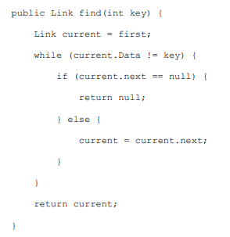
Linked List : Single Linked List
theList.find(22);
theList.find(22);
Head / First
current
44
22
Null
Head / First
current
44
22
Null

Slide 8
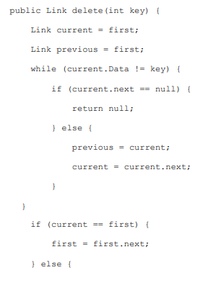
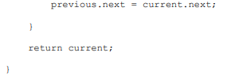
Linked List : Single Linked List
theList.insert(66);
theList.delete(44);
theList.delete(44);
Head
current
previous
66
44
22
Null
Head
current
previous
66
44
22
Null

Slide 9
Linked List : Single Linked List
theList.insert(66);
theList.delete(44);
theList.delete(44);
Head
current
previous
66
44
22
Null
Head
66
22
Null

Slide 10
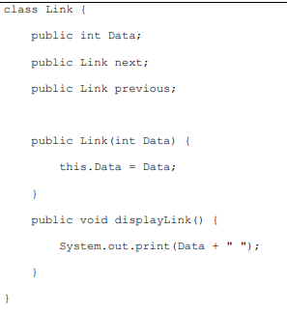
Linked List : Doubly Linked List
Pada source code disamping, kita akan membuat class Node (pada modul namanya ‘Link’)
prev
Data
next

Slide 11
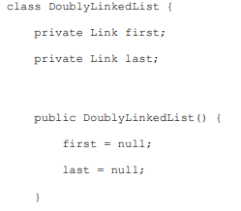
Linked List : Doubly Linked List
DoublyLinkedList theList = new DoublyLinkedList();
theList.insertFirst(22);
theList.insertLast(44);
DoublyLinkedList theList = new DoublyLinkedList();
Head
Tail
Null
Null

Slide 12
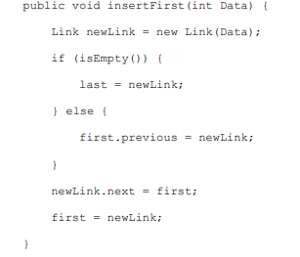
Linked List : Doubly Linked List
theList.insertFirst(22);
DoublyLinkedList theList = new DoublyLinkedList();
theList.insertFirst(22);
theList.insertLast(44);
Head
Tail
22
Null
Null
Head
Tail
22
Null
Head
Tail
22
Null

Slide 13
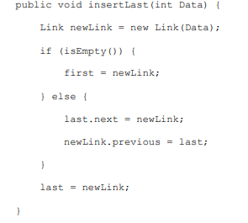
Linked List : Doubly Linked List
theList.insertLast(44);
DoublyLinkedList theList = new DoublyLinkedList();
theList.insertFirst(22);
theList.insertLast(44);
Head
Tail
44
22
Null
Head
Tail
22
44
Head
Tail
22
44

Slide 14
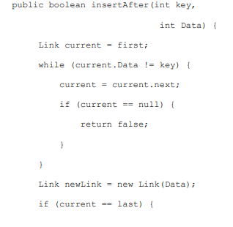
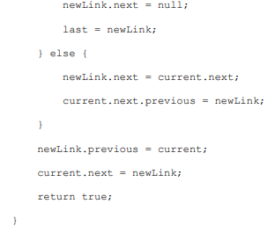
Linked List : Doubly Linked List
theList.insertAfter(22, 33);
theList.insertAfter(22, 33);
Head
current
Tail
22
44
Head
current
Tail
22
44
Tetap, soalnya sudah ketemu 22
33
Head
current
Tail
22
44

Slide 15
Linked List : Doubly Linked List
theList.insertAfter(22, 33);
theList.insertAfter(22, 33);
33
Tail
Head
current
22
44
Head
Tail
current
22
33
44

Slide 16
TERIMA KASIH

